Slide 1
Puzzling Perimeter - 2

Slide 2



Puzzling Perimeter - 2
Find the perimeter of the polygon, in which all sides are either vertical or horizontal.
$$14$$
(not drawn to scale)
$$18$$
$$16$$

Slide 3
Puzzling Perimeter - 2
$$14$$
$$18$$
$$16$$

Slide 4



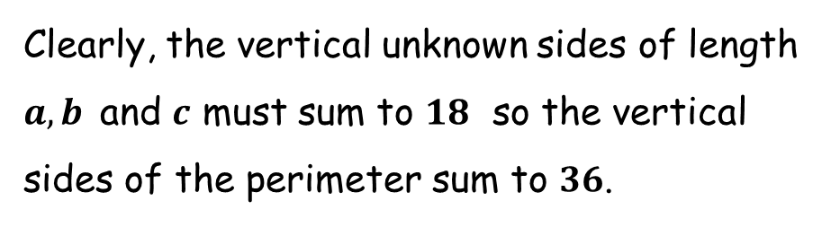



Puzzling Perimeter - 2
Clearly, the vertical unknown sides of length $a, b$ and $c$ must sum to $18$ so the vertical sides of the perimeter sum to $36$.
$$14$$
$$a$$
$$b$$
$$18$$
$$16$$
$$c$$

Slide 5


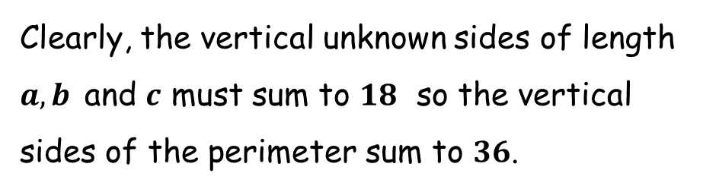


Puzzling Perimeter - 2
Clearly, the vertical unknown sides of length $a, b$ and $c$ must sum to $18$ so the vertical sides of the perimeter sum to $36$.
$$14$$
$$14−d$$
$$d$$
$14−d+16=e$
$30=d+e$
Perimeter $= 36+14+16+d+e$
$= 36+30+30$
$= 96$
$$18$$
$$16$$
$$e$$

Slide 6

Puzzling Perimeter - 2
Find the perimeter of the polygon, in which all sides are either vertical or horizontal.
$$14$$
Perimeter $= 96$
$$18$$
$$16$$

Slide 7
Puzzling Perimeter - 2
Find the perimeter of the polygon, in which all sides are either vertical or horizontal.
$$14$$
There is a smarter way to work it out…
$$18$$
$$16$$

Slide 8
Puzzling Perimeter - 2
Find the perimeter of the polygon, in which all sides are either vertical or horizontal.
$$14$$
$$18$$
$$16$$

Slide 9

Puzzling Perimeter - 2
Find the perimeter of the polygon, in which all sides are either vertical or horizontal.
Sliding parts of the perimeter as shown increases the perimeter by the green amount but simultaneously reduces it by the same red amount! The area may change, but the perimeter does not.
$$14$$
$$18$$
$$16$$

Slide 10

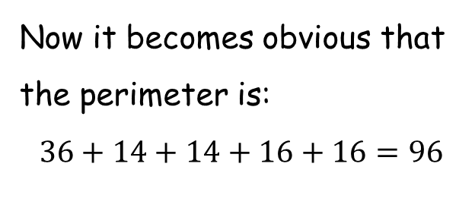
Puzzling Perimeter - 2
Find the perimeter of the polygon, in which all sides are either vertical or horizontal.
Now it becomes obvious that the perimeter is:
$$36+14+14+16+16=96$$
$$14$$
increase in perimeter
$$18$$
$$16$$
corresponding decrease in perimeter

Slide 11

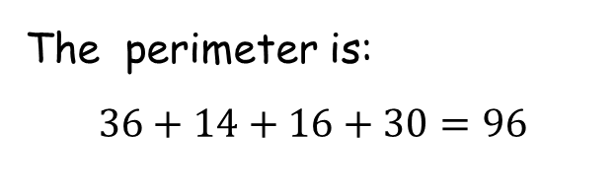
Puzzling Perimeter - 2
Find the perimeter of the polygon, in which all sides are either vertical or horizontal.
Sliding in the opposite direction works too.
$$14$$
decrease in perimeter
The perimeter is:
$$36+14+16+30=96$$
$$18$$
$$16$$
corresponding increase in perimeter

Slide 13

Note to Teacher
The answers are all the same.
The answer is the sum of the three numbers, doubled.
The sum on all worksheets is $46$ so the answers are all $92$.

Slide 14
RESOURCES

Slide 15

Puzzling Perimeter - 2
SIC_92
Find the perimeter of the polygon, in which all sides are either vertical or horizontal.
$$14$$
(not drawn to scale)
$$16$$
$$16$$

Slide 16

Puzzling Perimeter - 2
SIC_92
Find the perimeter of the polygon, in which all sides are either vertical or horizontal.
$$12$$
(not drawn to scale)
$$18$$
$$16$$

Slide 17


Puzzling Perimeter - 2
SIC_92
Find the perimeter of the polygon, in which all sides are either vertical or horizontal.
$$13$$
(not drawn to scale)
$$18$$
$$15$$

Slide 18


Puzzling Perimeter - 2
SIC_92
Find the perimeter of the polygon, in which all sides are either vertical or horizontal.
$$13$$
(not drawn to scale)
$$20$$
$$13$$

Slide 19


Puzzling Perimeter - 2
SIC_92
Find the perimeter of the polygon, in which all sides are either vertical or horizontal.
$$11$$
(not drawn to scale)
$$22$$
$$13$$

Slide 20



Puzzling Perimeter - 2
SIC_92
Find the perimeter of the polygon, in which all sides are either vertical or horizontal.
$$15$$
(not drawn to scale)
$$14$$
$$17$$

Slide 21

Puzzling Perimeter - 2
SIC_92
Find the perimeter of the polygon, in which all sides are either vertical or horizontal.
$$14$$
(not drawn to scale)
$$15$$
$$17$$

Slide 22

Puzzling Perimeter - 2
SIC_92
Find the perimeter of the polygon, in which all sides are either vertical or horizontal.
$$13$$
(not drawn to scale)
$$15$$
$$18$$

Slide 23
Puzzling Perimeter - 2
SIC_92
Find the perimeter of the polygon, in which all sides are either vertical or horizontal.
$$12$$
(not drawn to scale)
$$16$$
$$18$$

Slide 24

Puzzling Perimeter - 2
SIC_92
Find the perimeter of the polygon, in which all sides are either vertical or horizontal.
$$11$$
(not drawn to scale)
$$16$$
$$19$$

Slide 25

Puzzling Perimeter - 2
SIC_92
Find the perimeter of the polygon, in which all sides are either vertical or horizontal.
$$14$$
(not drawn to scale)
$$17$$
$$15$$

Slide 26
Puzzling Perimeter - 2
SIC_92
Find the perimeter of the polygon, in which all sides are either vertical or horizontal.
$$12$$
(not drawn to scale)
$$17$$
$$17$$

Slide 27
Puzzling Perimeter - 2
SIC_92
Find the perimeter of the polygon, in which all sides are either vertical or horizontal.
$$13$$
(not drawn to scale)
$$17$$
$$16$$

Slide 28

Puzzling Perimeter - 2
SIC_92
Find the perimeter of the polygon, in which all sides are either vertical or horizontal.
$$10$$
(not drawn to scale)
$$17$$
$$19$$

Slide 29
Puzzling Perimeter - 2
SIC_92
Find the perimeter of the polygon, in which all sides are either vertical or horizontal.
$$11$$
(not drawn to scale)
$$18$$
$$17$$

Slide 30

Puzzling Perimeter - 2
SIC_92
Find the perimeter of the polygon, in which all sides are either vertical or horizontal.
$$10$$
(not drawn to scale)
$$19$$
$$17$$

Slide 31
Puzzling Perimeter - 2
SIC_92
Find the perimeter of the polygon, in which all sides are either vertical or horizontal.
$$11$$
(not drawn to scale)
$$19$$
$$16$$

Slide 32
Puzzling Perimeter - 2
SIC_92
Find the perimeter of the polygon, in which all sides are either vertical or horizontal.
$$12$$
(not drawn to scale)
$$19$$
$$15$$

Slide 33

Puzzling Perimeter - 2
SIC_92
Find the perimeter of the polygon, in which all sides are either vertical or horizontal.
$$12$$
(not drawn to scale)
$$21$$
$$13$$

Slide 34


Puzzling Perimeter - 2
SIC_92
Find the perimeter of the polygon, in which all sides are either vertical or horizontal.
$$10$$
(not drawn to scale)
$$24$$
$$12$$

Slide 35



Puzzling Perimeter - 2
SIC_92
Find the perimeter of the polygon, in which all sides are either vertical or horizontal.
$$16$$
(not drawn to scale)
$$10$$
$$20$$

Slide 36

Puzzling Perimeter - 2
SIC_92
Find the perimeter of the polygon, in which all sides are either vertical or horizontal.
$$14$$
(not drawn to scale)
$$10$$
$$22$$

Slide 37

Puzzling Perimeter - 2
SIC_92
Find the perimeter of the polygon, in which all sides are either vertical or horizontal.
$$18$$
(not drawn to scale)
$$10$$
$$18$$

Slide 38

Puzzling Perimeter - 2
SIC_92
Find the perimeter of the polygon, in which all sides are either vertical or horizontal.
$$16$$
(not drawn to scale)
$$13$$
$$17$$

